Slide 1
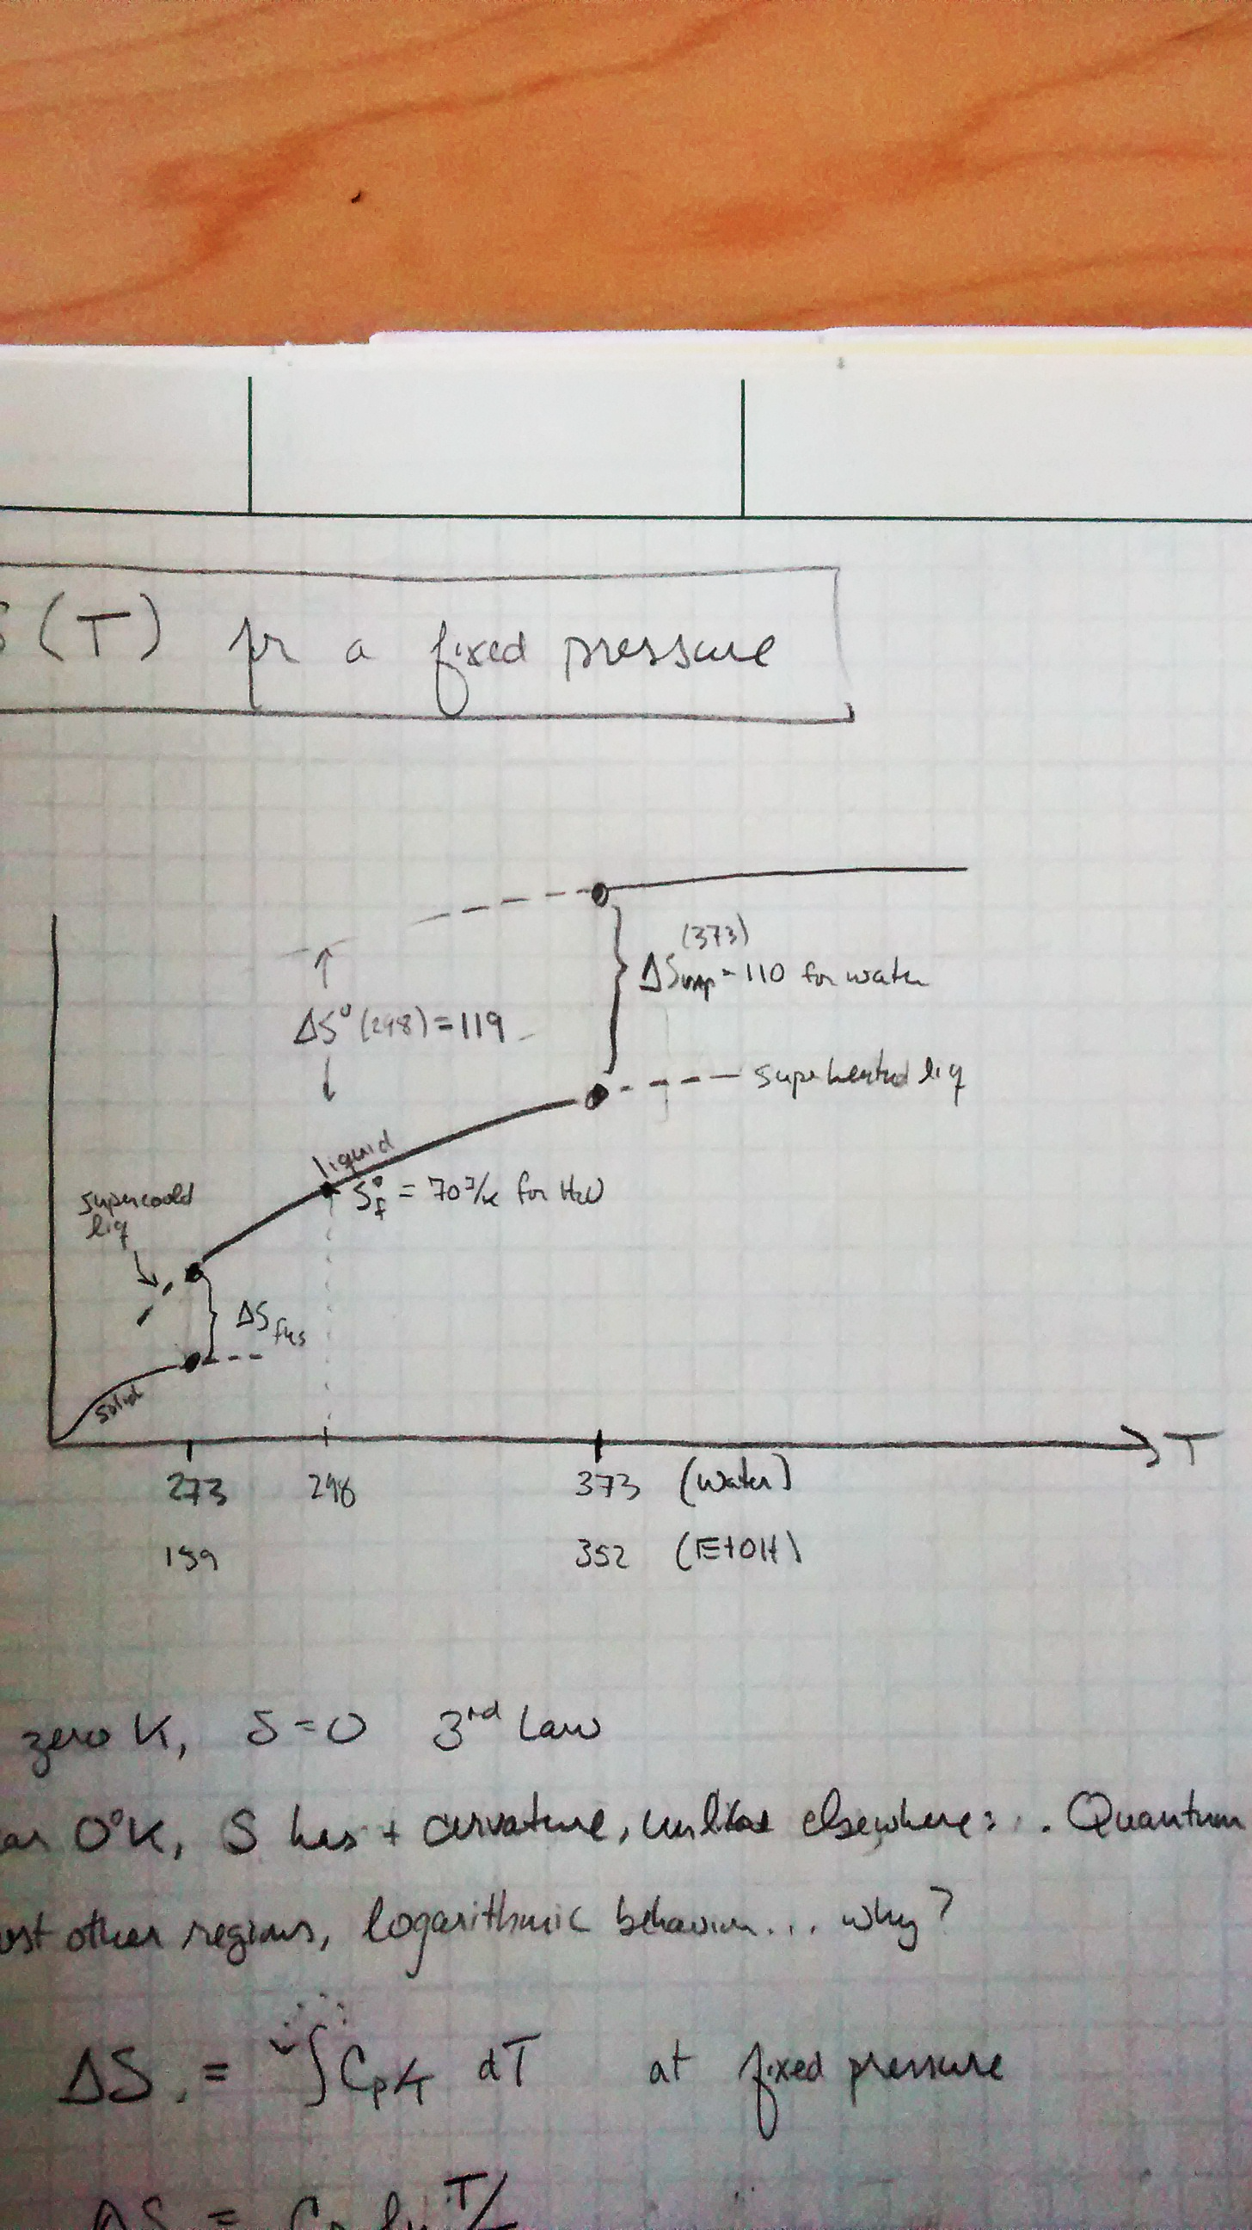

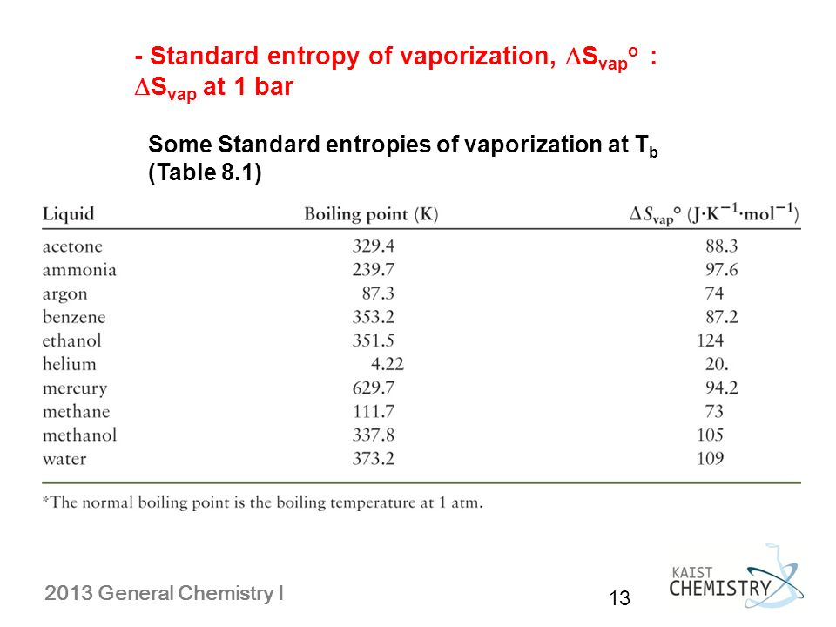
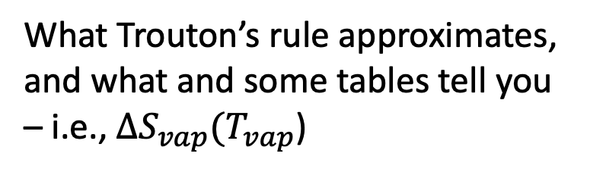
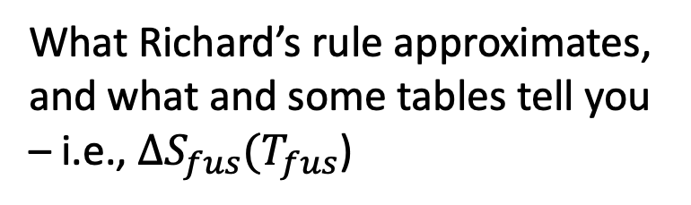

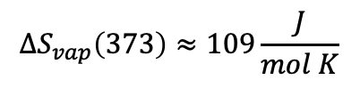


Last time … Trouton and Richard
Standard state entropies of formation (at 298 K)
What Trouton’s rule approximates, and what and some tables tell you – i.e., $∆S_{vap}(T_{vap}$)
S
$$∆S_{vap}\left(373\right)≈109\frac{J}{mol K}$$
$$∆S_{vap}(T_{boiling})$$
$$Liquid$$
$$T_{boiling}$$
What Richard’s rule approximates, and what and some tables tell you – i.e., $∆S_{fus}(T_{fus}$)

Slide 2
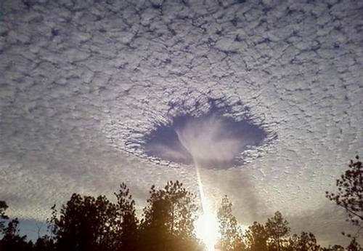
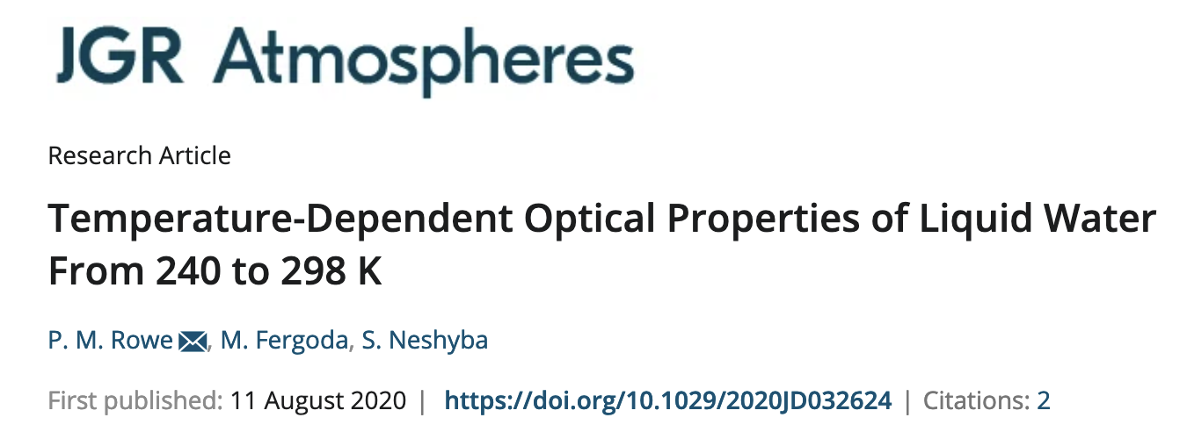
In some cases, we can observe these supercooled and superheated states
https://forum.xcitefun.net/punch-hole-clouds-layer-of-supercooled-clouds-t16564.html
S

Slide 3
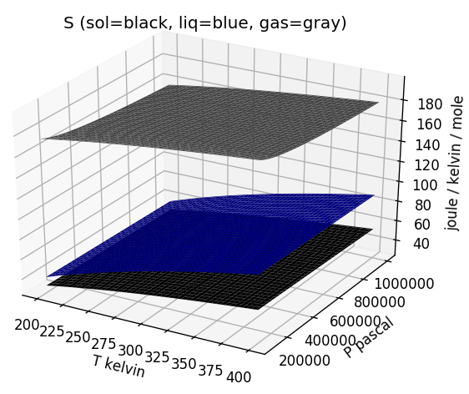
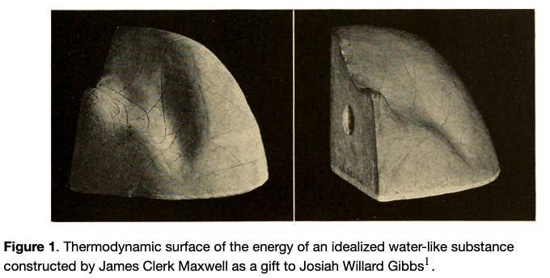
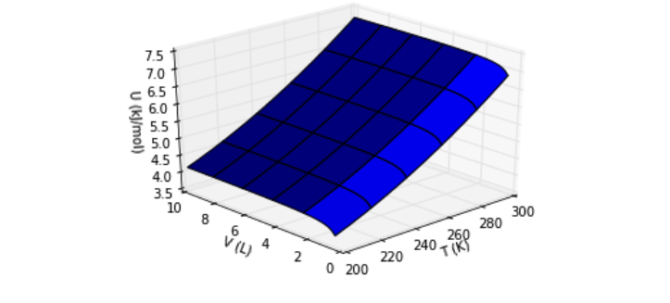

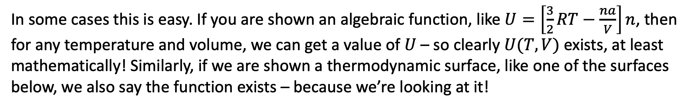

Existence check: How to tell whether a state function actually exists
In some cases this is easy. If you are shown an algebraic function, like $U=\left[\frac{3}{2}RT−\frac{na}{V}\right]n$, then for any temperature and volume, we can get a value of $U$ – so clearly $U(T,V)$ exists, at least mathematically! Similarly, if we are shown a thermodynamic surface, like one of the surfaces below, we also say the function exists – because we’re looking at it!
$$S(T,P)$$
$$U(T,V)$$

Slide 4
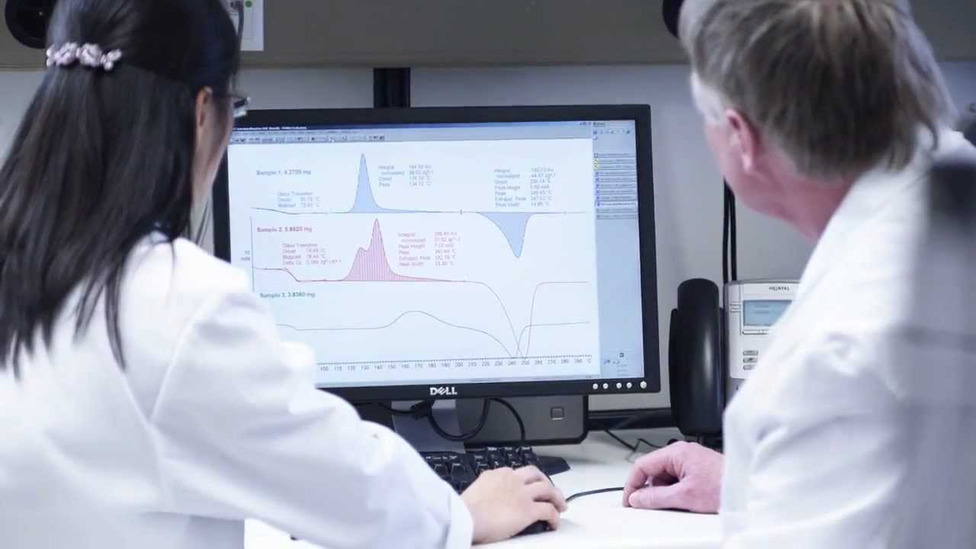
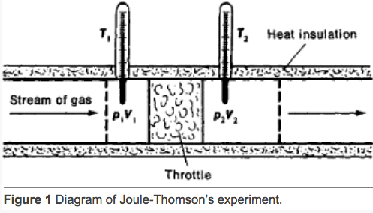
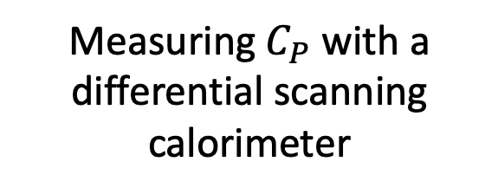
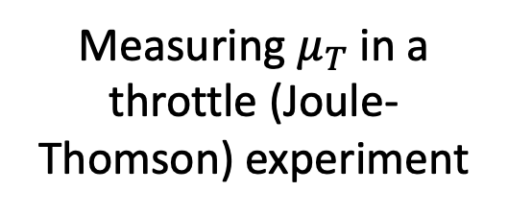
Existence check: How to tell whether a state function actually exists
In other cases, it’s not so obvious. Say we’ve measured $C_{P}$and $μ_{T}$ for some substance. Great, they exist.
Measuring $C_{P}$ with a differential scanning calorimeter
Measuring $μ_{T}$ in a throttle (Joule-Thomson) experiment
But how do we know there’s a thermodynamic surface $H(T,P)$ that goes along with
$dH=C_{P}dT+μ_{T}dP$?

Slide 5
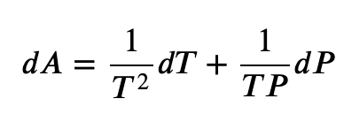
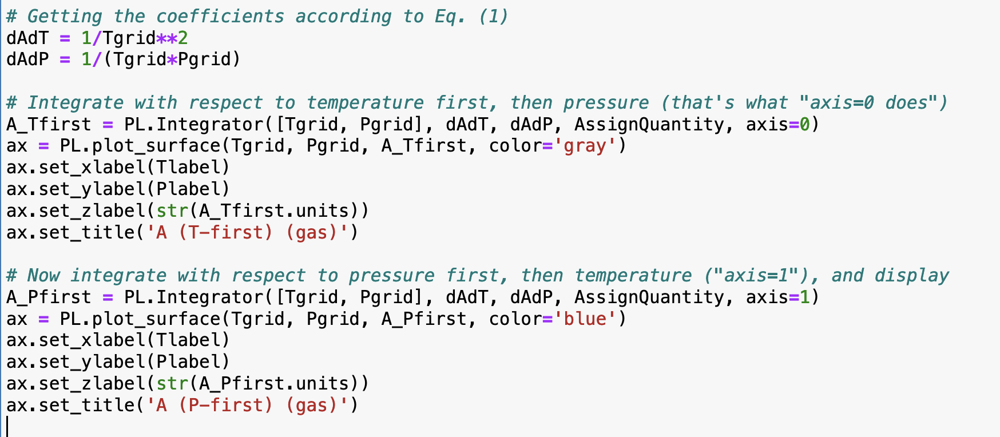
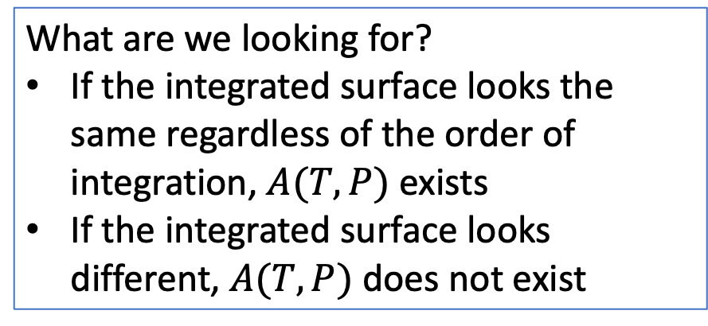
One method is cross-integration
What are we looking for?
If the integrated surface looks the same regardless of the order of integration, $A(T,P)$ exists
If the integrated surface looks different, $A(T,P)$ does not exist

Slide 6
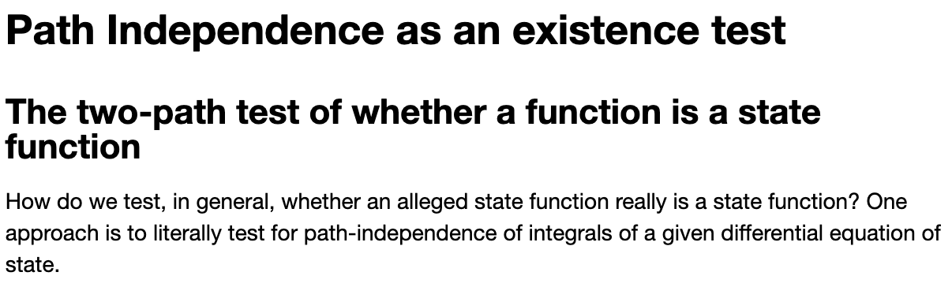
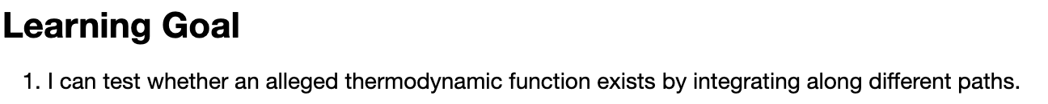
OK, let’s get started

Slide 7
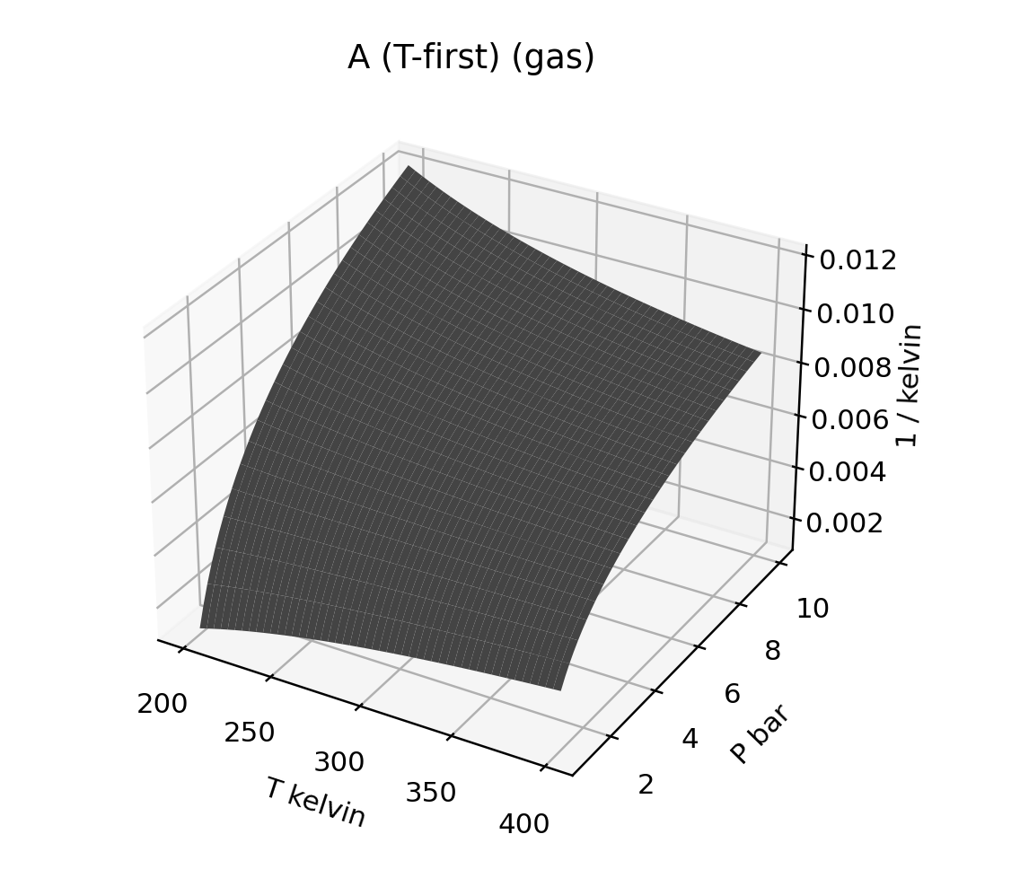
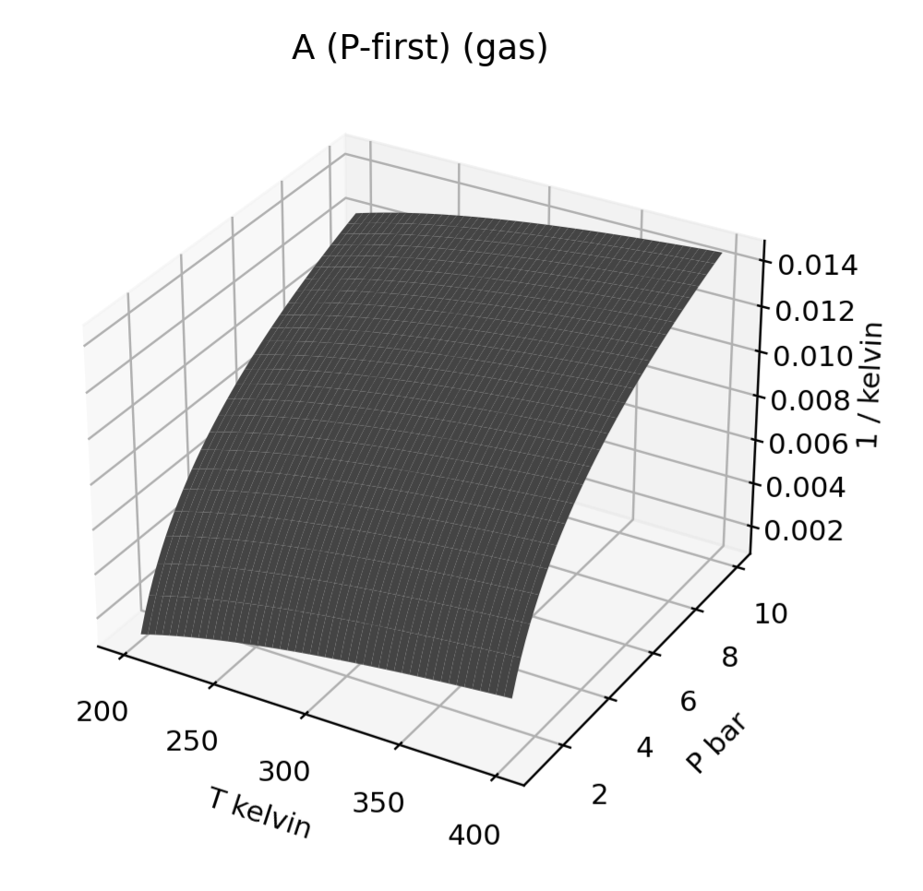
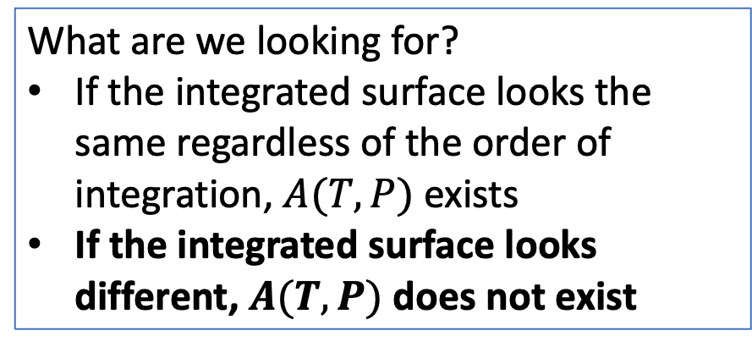
Results from our cross-integration test
What are we looking for?
If the integrated surface looks the same regardless of the order of integration, $A(T,P)$ exists
If the integrated surface looks different, $A(T,P)$ does not exist

Slide 8
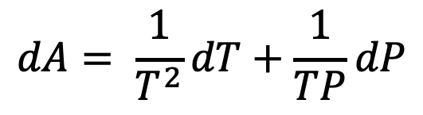
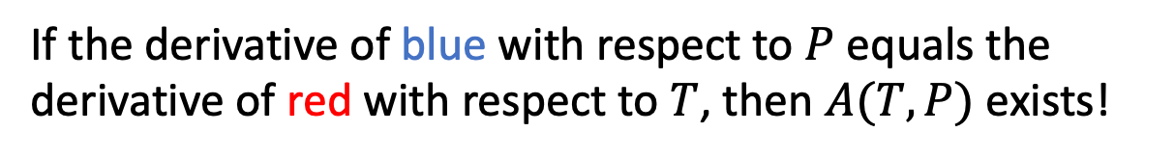
There’s also the cross-derivative test for existence
$$dA= \frac{1}{T^{2}}dT+\frac{1}{TP}dP$$
If the derivative of blue with respect to $P$ equals the derivative of red with respect to $T$, then $A(T,P)$ exists!

Slide 9
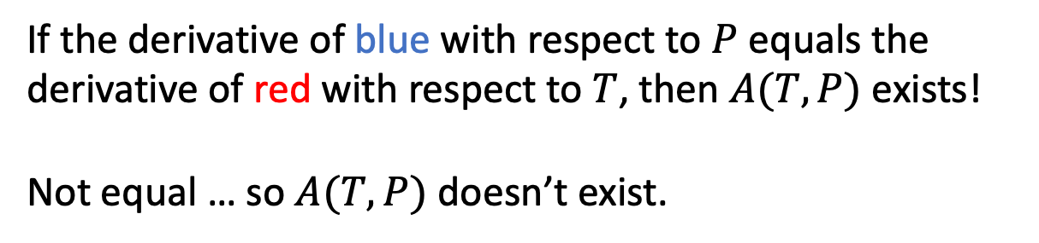
There’s also the cross-derivative test for existence
$$dA= \frac{1}{T^{2}}dT+\frac{1}{TP}dP$$
If the derivative of blue with respect to $P$ equals the derivative of red with respect to $T$, then $A(T,P)$ exists!
Not equal … so $A(T,P)$ doesn’t exist.

Slide 10

Another cross-derivative test for existence
$$dA=P dT+T dP$$
If the derivative of blue with respect to $P$ equals the derivative of red with respect to $T$, then $A(T,P)$ exists!

Slide 11
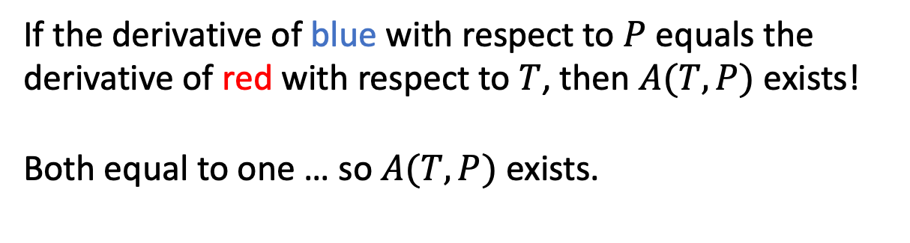
Another cross-derivative test for existence
$$dA=P dT+T dP$$
If the derivative of blue with respect to $P$ equals the derivative of red with respect to $T$, then $A(T,P)$ exists!
Both equal to one … so $A(T,P)$ exists.

Slide 12
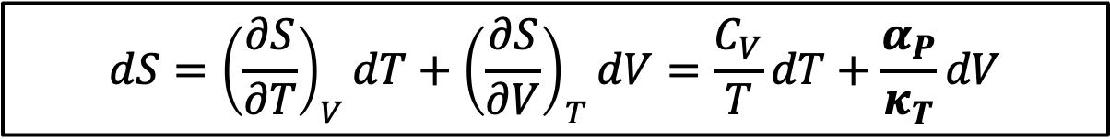
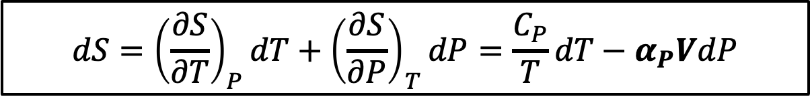
Remaining tasks: how those crazy terms appear on the RHS of $dS=$ …
$$dS={\left(\frac{∂S}{∂T}\right)}_{P}dT+{\left(\frac{∂S}{∂P}\right)}_{T}dP=\frac{C_{P}}{T}dT−α_{P}VdP$$
$$dS={\left(\frac{∂S}{∂T}\right)}_{V}dT+{\left(\frac{∂S}{∂V}\right)}_{T}dV=\frac{C_{V}}{T}dT+\frac{α_{P}}{κ_{T}}dV$$

Slide 13
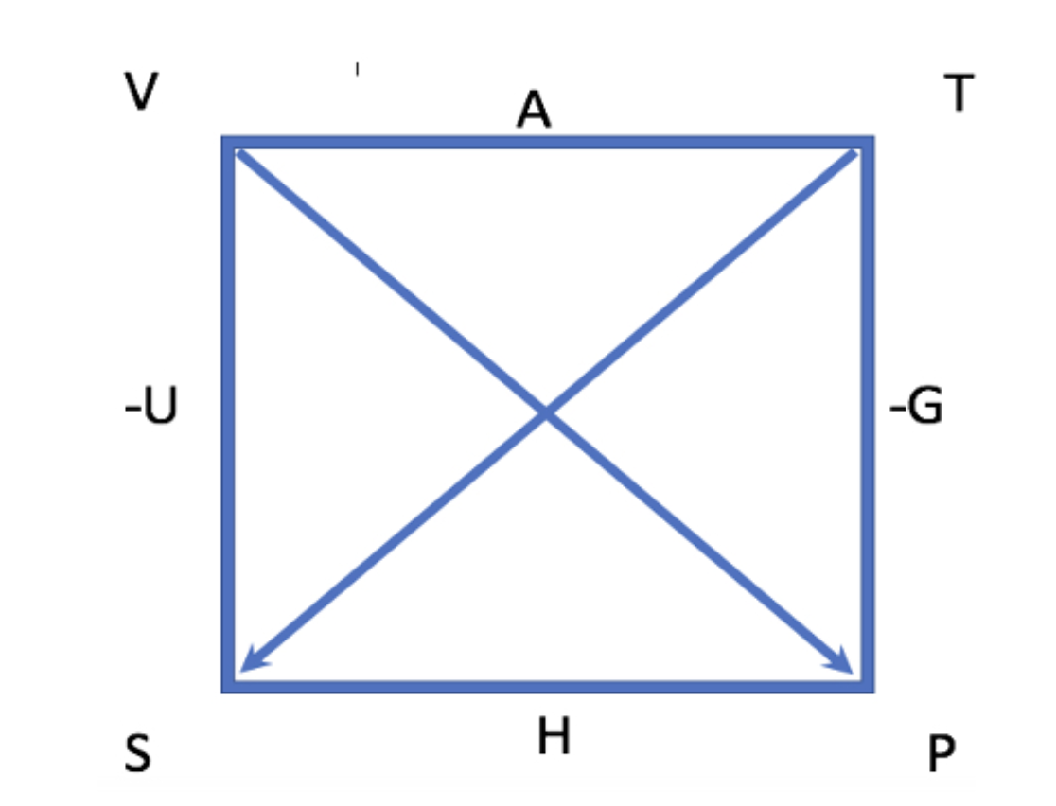
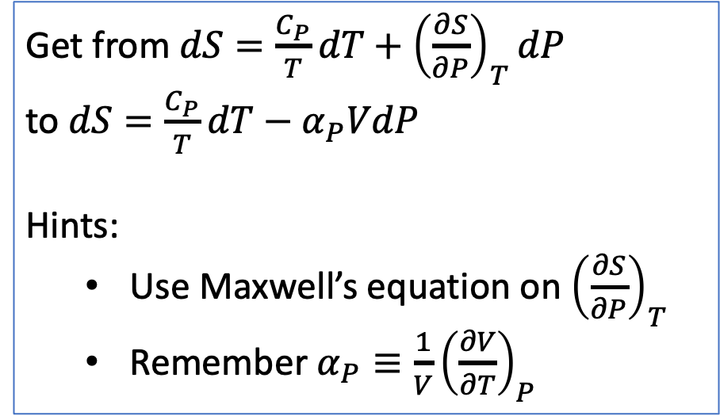
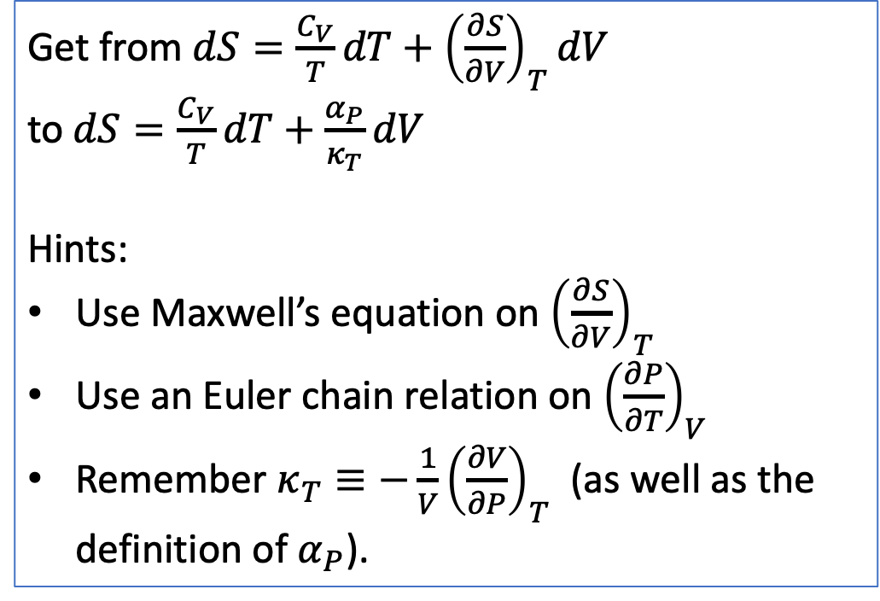
Remaining tasks: how those crazy terms appear on the RHS of $dS=$ …
Get from $dS=\frac{C_{P}}{T}dT+{\left(\frac{∂S}{∂P}\right)}_{T}dP$
to $dS=\frac{C_{P}}{T}dT−α_{P}VdP$
Hints:
Use Maxwell’s equation on ${\left(\frac{∂S}{∂P}\right)}_{T}$
Remember $α_{P}≡\frac{1}{V}{\left(\frac{∂V}{∂T}\right)}_{P}$
Get from $dS=\frac{C_{V}}{T}dT+{\left(\frac{∂S}{∂V}\right)}_{T}dV$
to $dS=\frac{C_{V}}{T}dT+\frac{α_{P}}{κ_{T}}dV$
Hints:
Use Maxwell’s equation on ${\left(\frac{∂S}{∂V}\right)}_{T}$
Use an Euler chain relation on ${\left(\frac{∂P}{∂T}\right)}_{V}$
Remember $κ_{T}≡−\frac{1}{V}{\left(\frac{∂V}{∂P}\right)}_{T}$ (as well as the definition of $α_{P}$).

